Slide 1
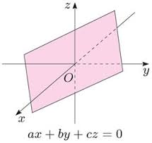
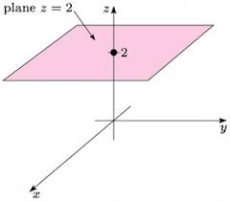
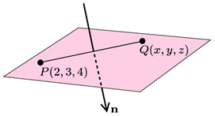
Vector equations( parametric equations)
of surfaces
For the domain of
see past exam papers
Planes
(1)

Slide 2
(2)
(3)
(4)

Slide 3
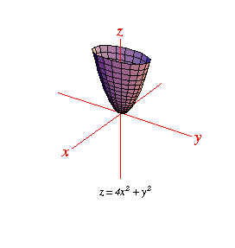
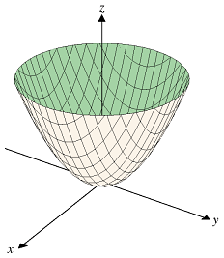
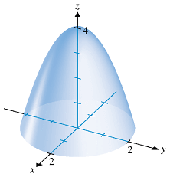
(B) Paraboloid
Inverted paraboloid

Slide 4
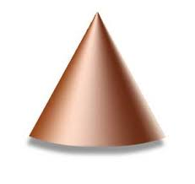
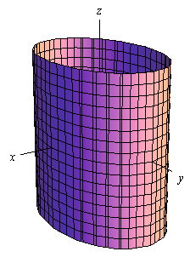
(C) Cone and elliptic cylinder
elliptic cylinder

Slide 5
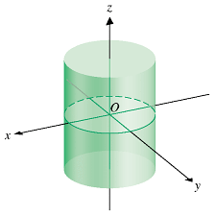
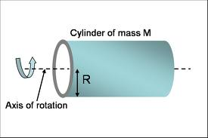
(D) Circular cylinder
y-axis

Slide 6
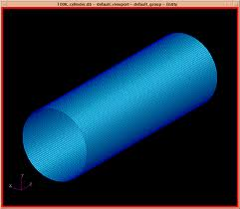
x-axis

Slide 7

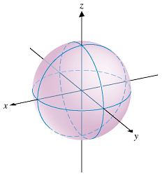

(E) Spheres ( with radius a)
● Full sphere :
● Upper hemisphere :

